Slide 1
Functional Programming
By: Hamzeh Saleh

Slide 2
01
What is Functional Programming
Programming paradigm or coding style designed to handle pure functions. This paradigm is totally focused on writing more compounded and pure functions.

Slide 3
Functional Programming is Declarative
02
Imperative Programming
programming style that we specify the program logic, by describing the flow control
Declarative Programming
programming style that we specify the program logic, without describing the flow control

Slide 4
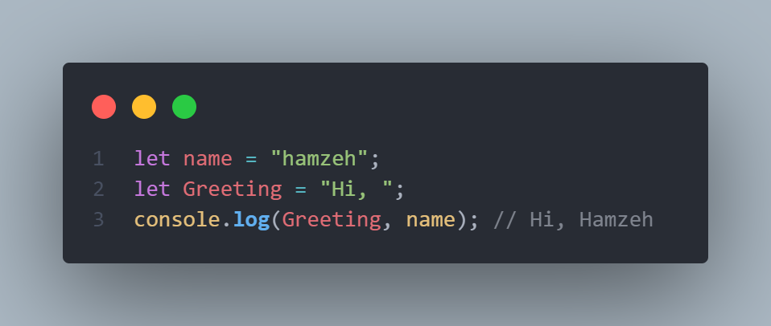
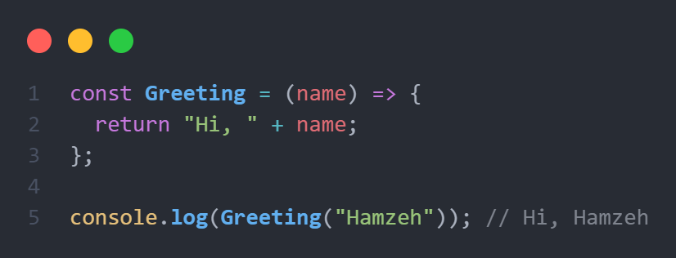
Examples of Imperative and Declarative
Imperative
Declarative

Slide 5
03
Pure Functions
Simple and reusable, they completely independent of the outside state (global variables), easy to refactor, test and debug.
Pure function is a function which given the same input, will always return the same output.

Slide 6
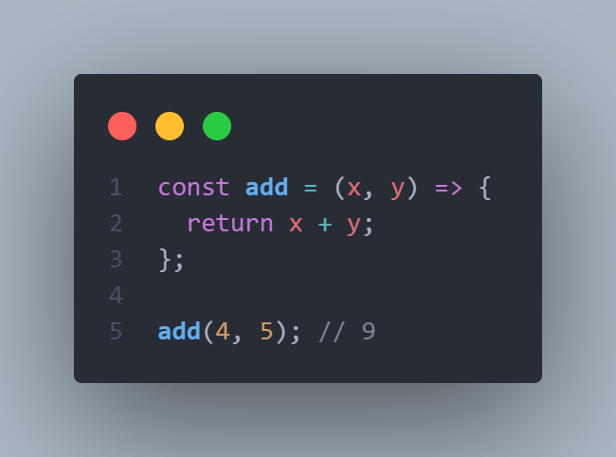
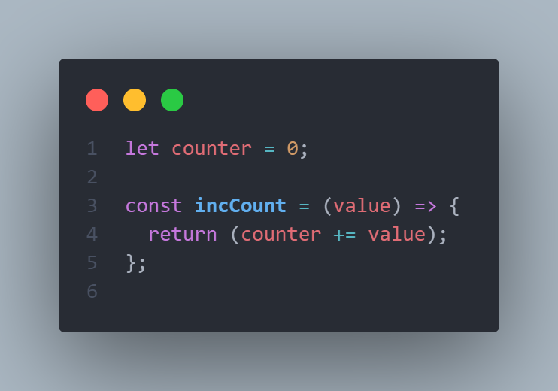
Examples of Pure and Not Pure Functions
Pure
Not Pure

Slide 7
04
Higher Order Functions
Functions that take other functions as inputs, or functions that return functions as its output.
(Functions can be inputs or outputs).

Slide 8
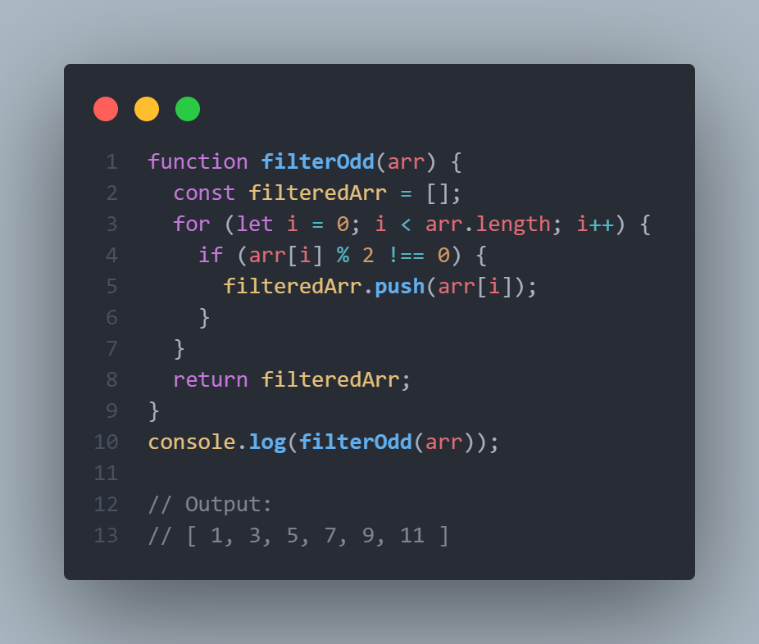

Examples of Higher Order Functions
Q: Suppose this given array arr = [1, 2, 3, 4, 5, 6, 7, 8, 9, 10, 11]

Slide 9
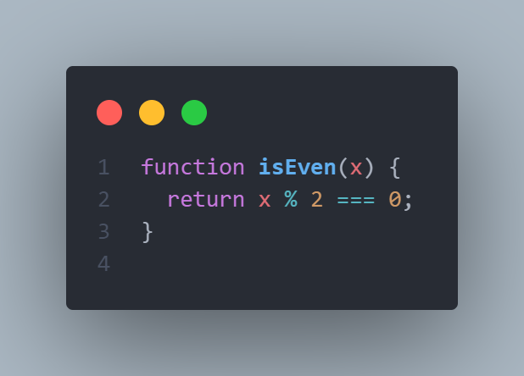
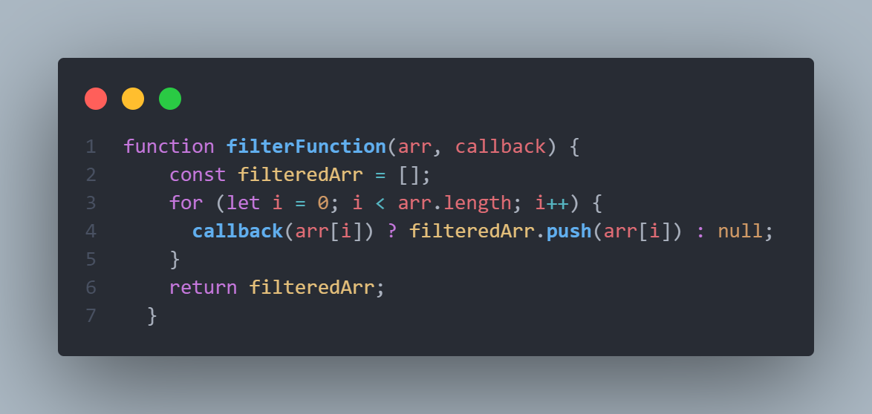
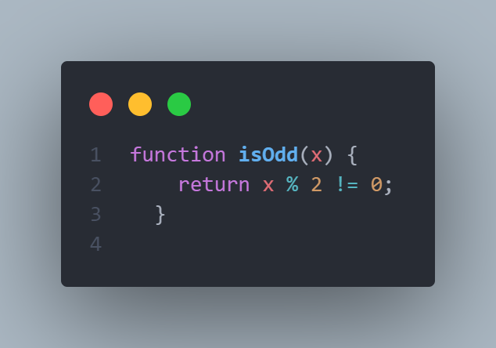
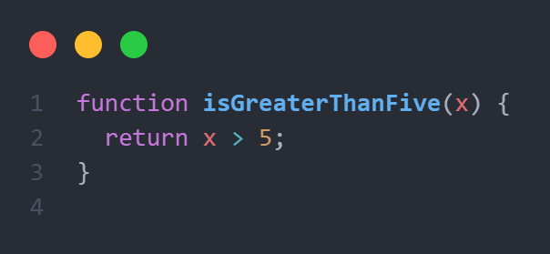
Examples of Higher Order Functions
Q: Suppose this given array arr = [1, 2, 3, 4, 5, 6, 7, 8, 9, 10, 11]

Slide 10
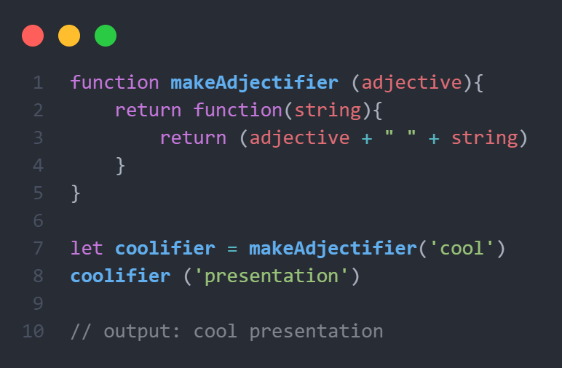
Examples of Higher Order Functions

Slide 11
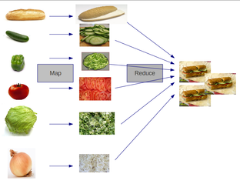
Don’t Iterate
05
Don’t use Loops …. Use Array methods

Slide 12
Avoid Mutability
06
Mutation
var rooms = [“H1”, “H2”, “H3”];
rooms[2] = “H4”;
rooms;
=> ["H1", "H2", "H4"]
No Mutation
var rooms = [“H1”, “H2”, “H3”];
Var newRooms = rooms.map(function (rm) {
if (rm == “H3”) { return “H4”; }
else { return rm; }
});

Slide 13
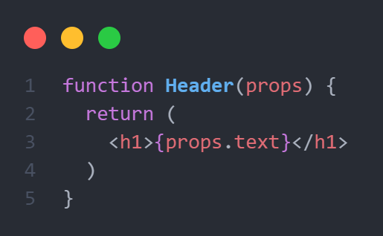
Functional Programming in React
07
React uses the functions to make the components, these functions are pure functions.

Slide 14
Thanks!
Any Questions ?

